Slide 1

Project GoNavy!
Gustavo Hammerschmidt, Jonathan Scott, and Erik Shepard

Slide 2
Application’s Purpose:
Currently, the managing staff utilize stand-alone programs such as Excel, Word, Google Sheets and e-mail to maintain the large amount of data throughout every term.
A lot of errors occur due to inconsistencies when documenting, which leads to misinformation and confusion.
Some documents may be reproduced many times, which increase the odds for an error to occur.

Slide 3
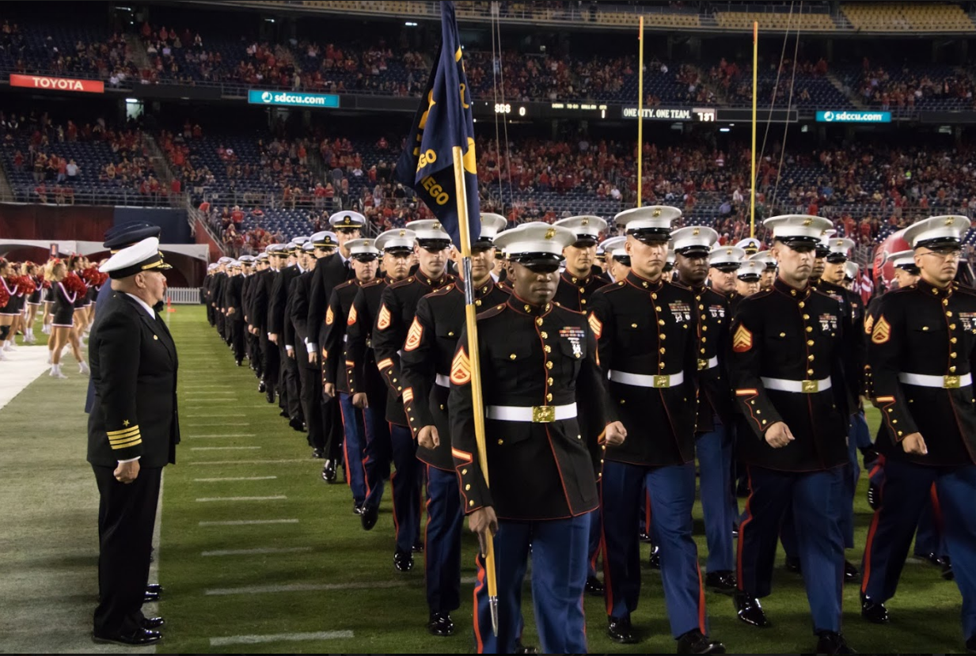

We Present:
GoNavy!
(a.k.a. NROTC Project)

Slide 4
The GoNavy! Application:
GoNavy is a domain-focused application.
Its users are members of the San Diego
Naval Reserve Officer Training Corps (NROTC).
It was conceived as a application to replace and centralize current applications used by the NROTC San Diego Staff.

Slide 5
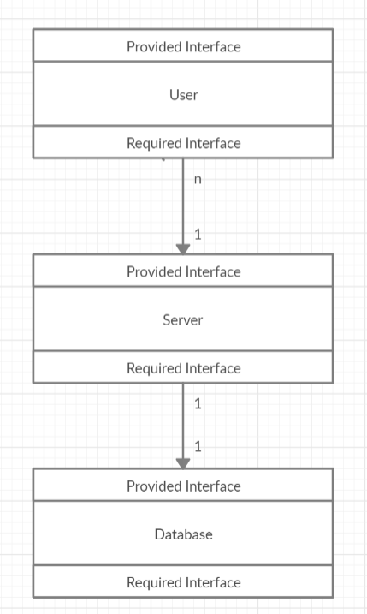
The Design:
We chose to make a client-server application.
We will have many users logged into the client-side application, which is a page on the user’s browser.
Some functions will be available to some users depending on their billet.
The server will handle users’ requests to access the database, that will run on the same computer.

Slide 6
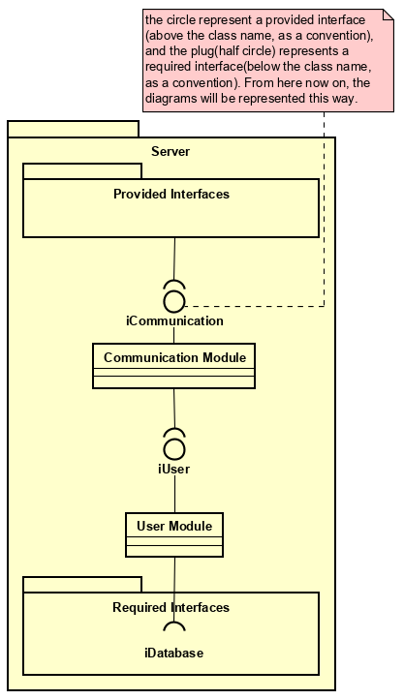
High-level Architecture of the server:
Communication Sub-Module.
Provides interface methods to the User module.
User Sub-Module.
Utilizes database provided methods for the user to operate on the database.

Slide 7
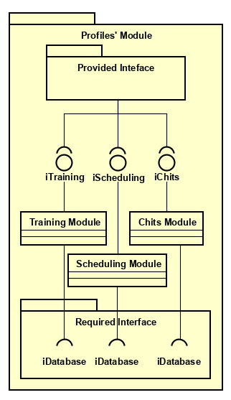
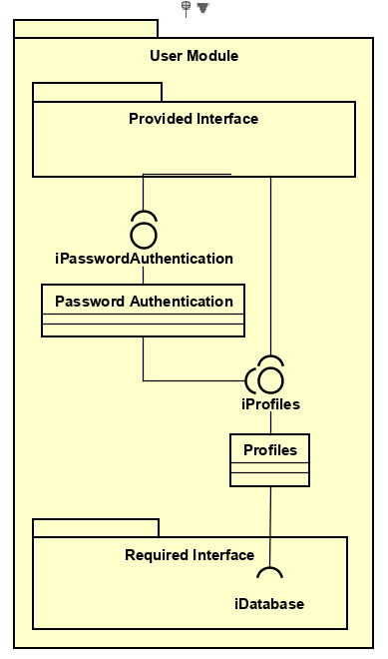
User Sub-Module:

Slide 8

Development Method
Notes:
Jon

Slide 9











Tools used in the project:
Server Side
Client Side
Supported Browsers
Development Tools
Notes:
Jon

Slide 10
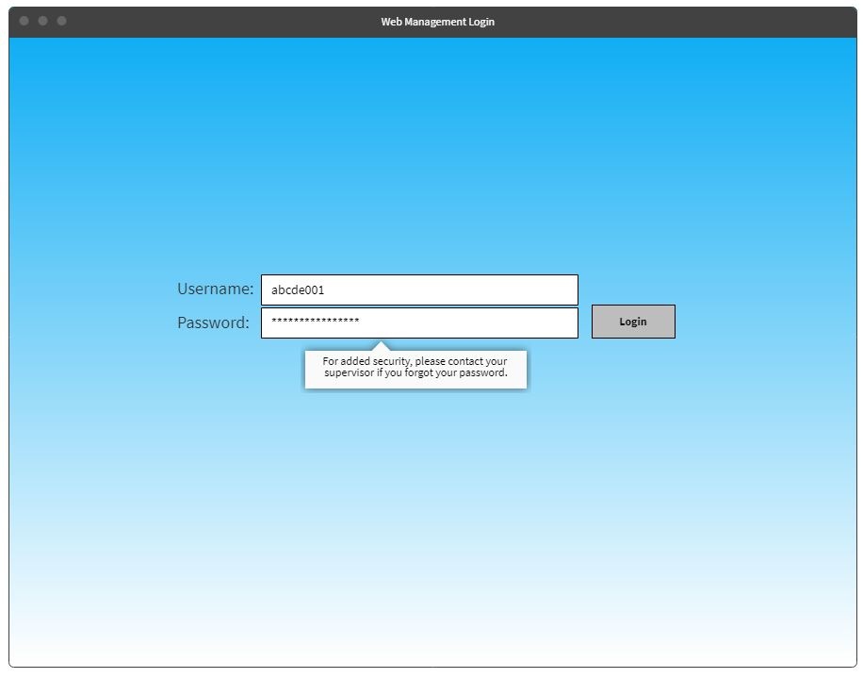
Functional Requirements
SR.01 The system shall allow any user to securely login using their username and password.
Notes:
Login screen

Slide 11
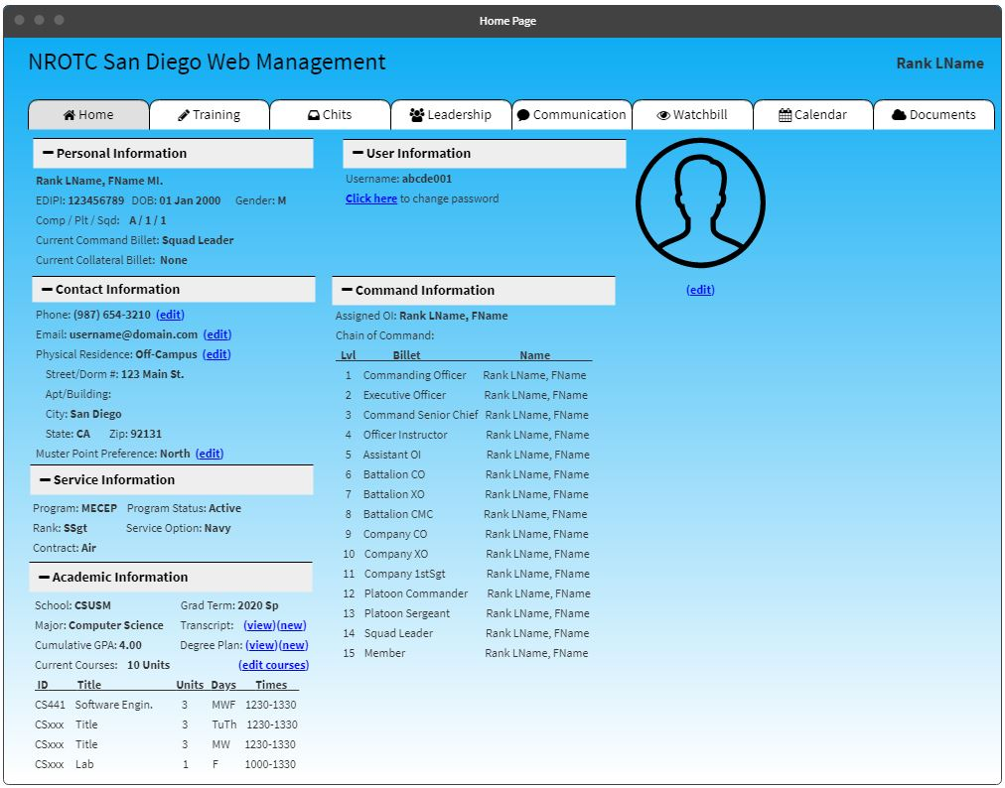
Functional Requirements
SU.01 The system shall have a student profile page where Demographic, Service, Command, Academic, Training, and Watchbill data is listed and can be viewed by the individual student user
SU.02 The system shall list in the Demographic section the student’s username, rank, last name, first name, middle initial, assignment identifier, EDIPI, date of birth, gender, program, status, service option, and service contract.
SU.03 The system shall list in the Demographic section the student’s contact information containing their phone number, physical address, and muster point. The student shall have the option to edit the contact information.
SU.04 The system shall list in the Academic section the student’s school, major, expected graduation term, and cumulative GPA.
SU.05 The system shall list in the Academic section all of the student’s current courses with the course ID, title, number of units, weekdays, and times.
SU.07 The system shall allow for the student to maintain a current copy of their transcript in the Academic section. Each upload shall overwrite the previous file.
Notes:
Profile Screen

Slide 12
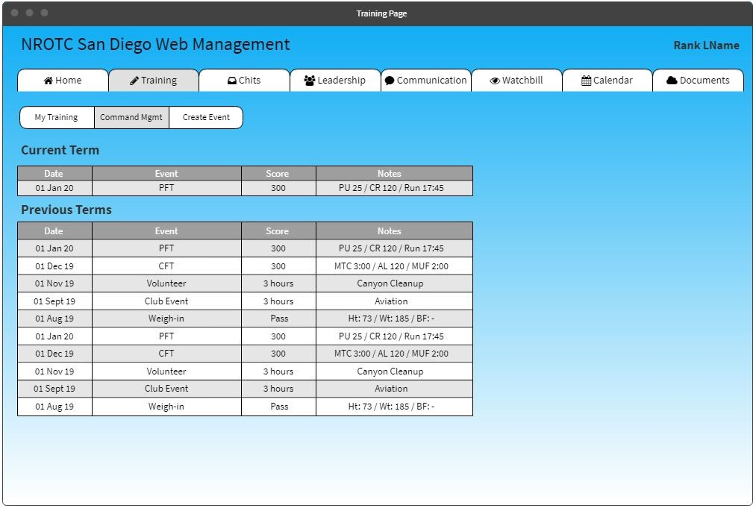
Functional Requirements
SU.11 The system shall list in the Training section all of the physical fitness test data for the student sorted by date. The most current shall be on top. Data shall include the date, event title, and total score.
SU.12 The system shall list in the Training section all of the weigh-in data for the student sorted by date. The most current shall be on top. Data shall include the date, height, weight, body fat percentage, and pass/fail.
SU.13 The system shall list in the Training section all of the service training event data for the student sorted by date. The most current shall be on top. Data shall include the date and event title.
SU.14 The system shall list in the Training section all of the club event data for the student sorted by date. The most current shall be on top. Data shall include the date and event title.
SU.15 The system shall list in the Training section all of the volunteer data for the student sorted by date. The most current shall be on top. Data shall include the date, event title, and the event duration (hours).

Slide 13
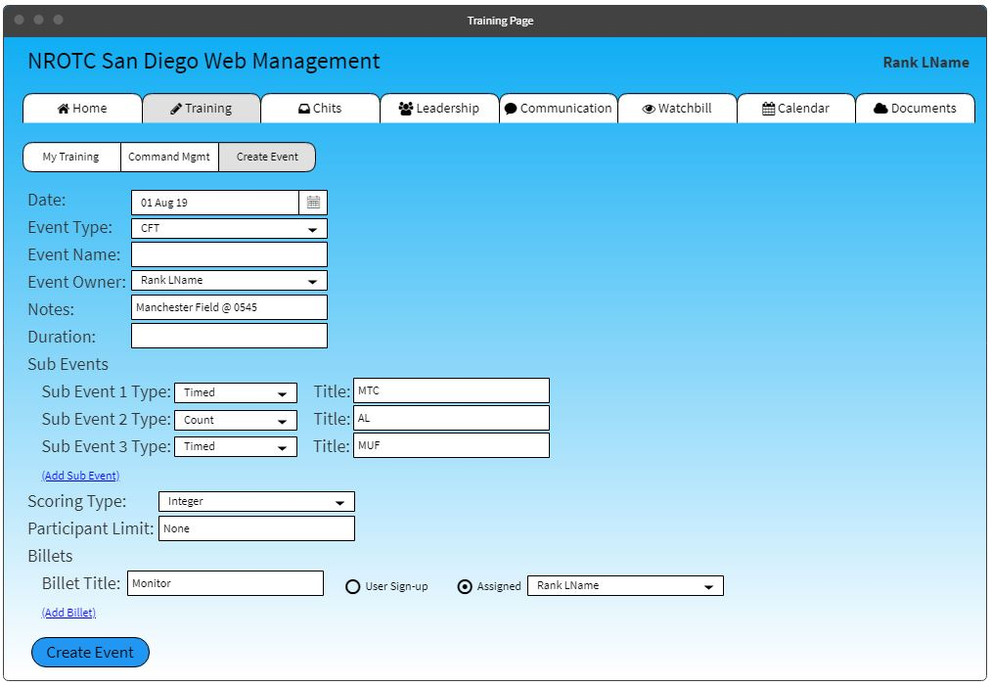
Functional Requirements
TS.02 1 The system shall allow any authorized users to initiate a new training event.
TS.03 1 For every new training event, the system shall allow the user to select an event type, which will consist of ’Club Event’, ’Community Service Event’, ’Physical Fitness Event’, ’Weigh-In Event’, or ’Other Training Event’.
TS.PF.03 1 The system shall allow each sub-event to record a score that is an integer.

Slide 14
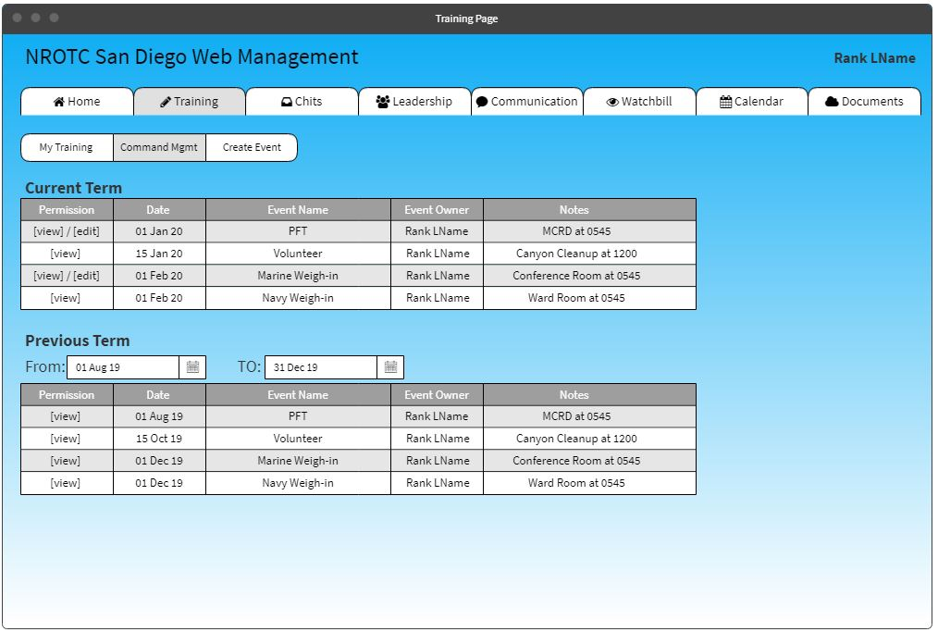
Functional Requirements
TS.01 1 The system shall have a Training section to be accessible by all users.
TS.07 1 The system shall allow the event owner to edit the event at any time.

Slide 15
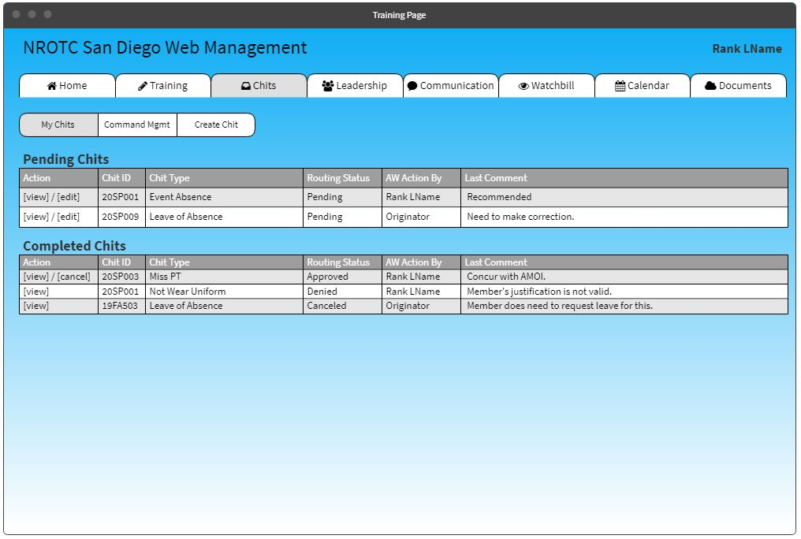
Functional Requirements
CHIT.01 The system shall allow a user to submit a request for a chit approval.
CHIT.02 The system shall allow a user to cancel a previously requested chit.
CHIT.03 The system shall allow a user to edit a previously requested chit.
CHIT.17 The system shall include three views for the chit system: ’New Chit Request’, ’My Submitted Chits’, and ’Command View’.
CHIT.19 In the ’My Submitted Chits’ view, the system shall allow any user to view all submitted chits and the current status for only the user’s submitted chits. The system shall also allow the user to edit or cancel any active chits.

Slide 16
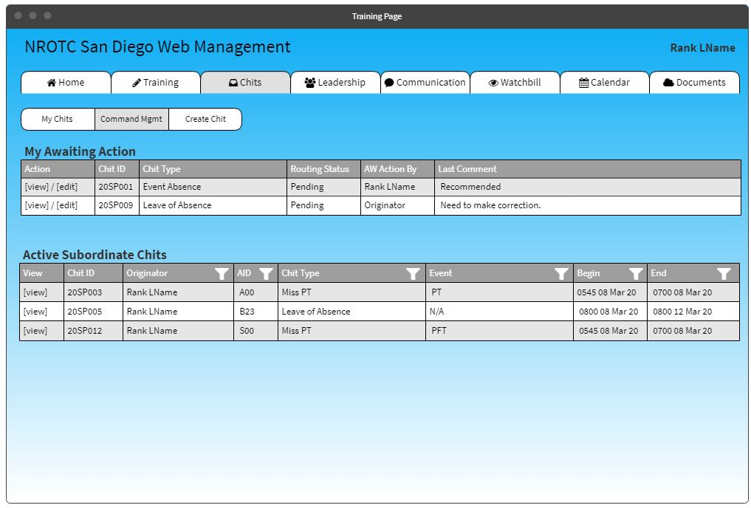
Functional Requirements
CHIT.12 The system shall sequentially allow each user within the originator’s CoC to make a comment and make a decision one at a time beginning from the lowest member in the CoC to the highest member.
CHIT.21 In the ’Command View’, the system shall have a subview for ’My Action’ and ’My Command’.
CHIT.22 In the ’My Action’ view, the system shall display all chits awaiting action for that user, allow the user to view the chit, and allow the user to comment and take action.
CHIT.23 In the ’My Command’, the system shall list all active chits for all members under that user’s CoC.

Slide 17
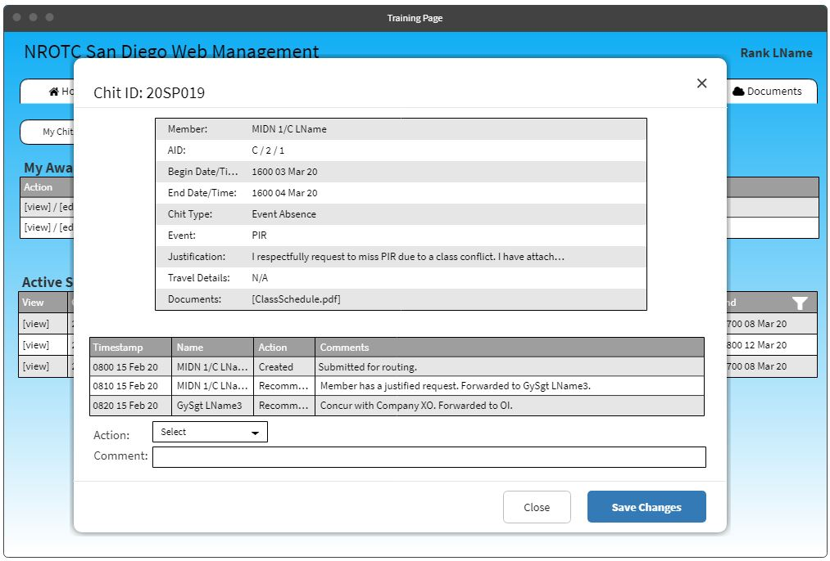
Functional Requirements
CHIT.06 The system shall implement a new comment log for each submitted chit with a timestamp and the user’s name for each comment.
CHIT.07 The system shall log a comment at the moment the chit was submitted, a decision is made, the chit was resubmitted, the chit is acknowledged, and/or when the chit was canceled.
CHIT.10 The system shall restart the approval process to the originator once the ‘Rework’ method has been initiated.
CHIT.11 The system shall allow users within the originator’s CoC to be able to comment on the chit and make a single decision choice of ’Recommend’, ’Not Recommend’, ’Approve’, ’Disapprove’, or ’Rework’.
CHIT.12 The system shall sequentially allow each user within the originator’s CoC to make a comment and make a decision one at a time beginning from the lowest member in the CoC to the highest member.

Slide 18
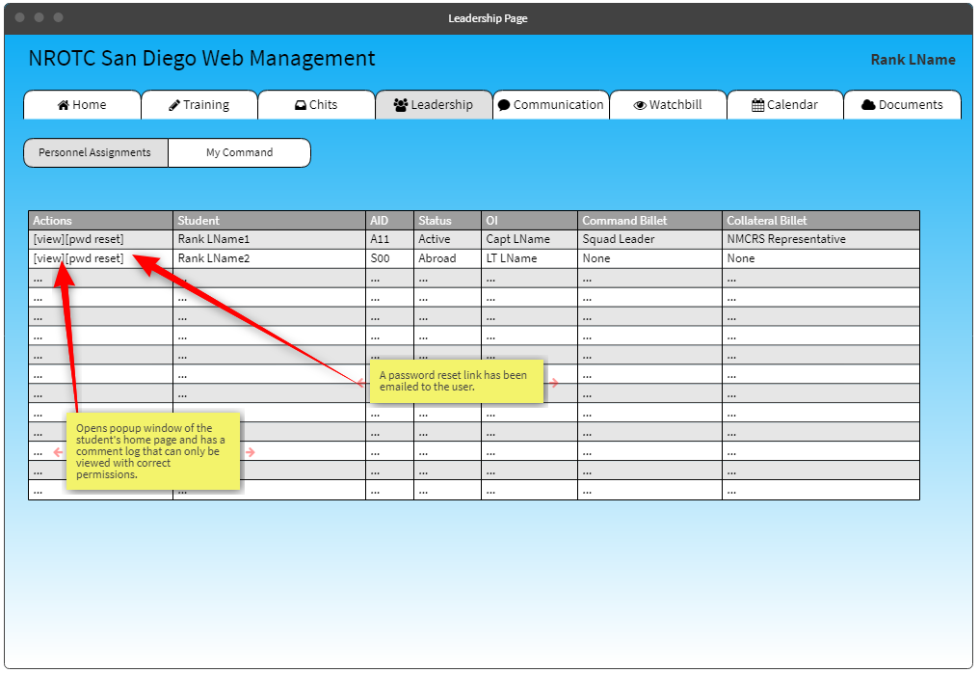
Functional Requirements
STF.01 1 The system shall have a staff profile page that contains Demographic and Students Assigned sections.
STF.05 2 The system shall include a comment log link for each student line. This will allow the staff member to annotate comments on the student that is only visible to other staff members. Comments shall be time stamped and also log the last name of the user who logs a comment.

Slide 19
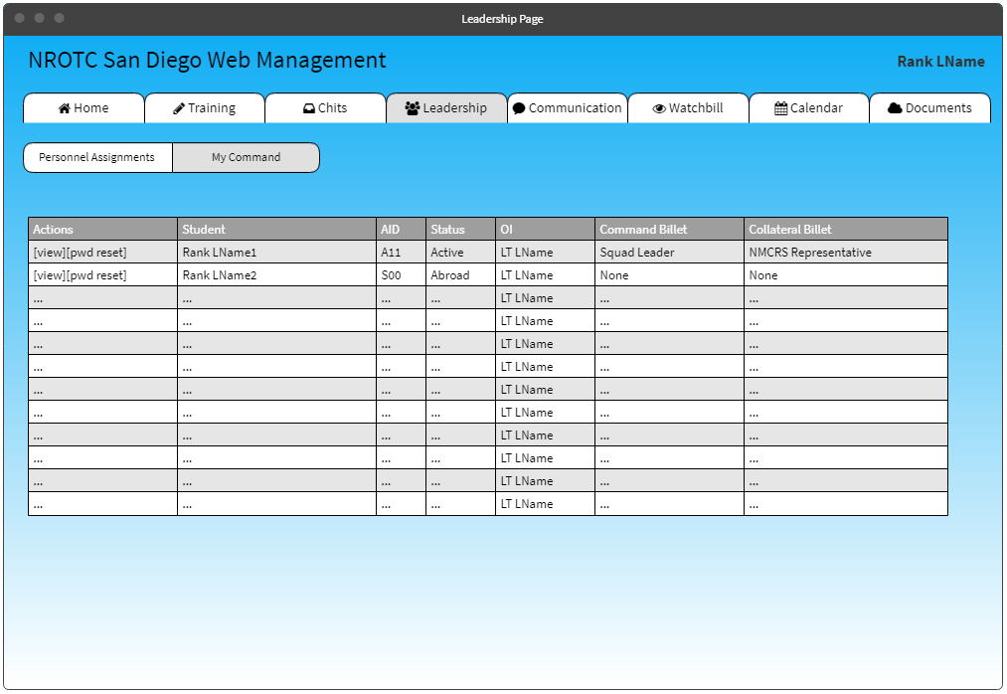
Functional Requirements
Extra Feature that allows view of all students under the current user’s command.

Slide 20
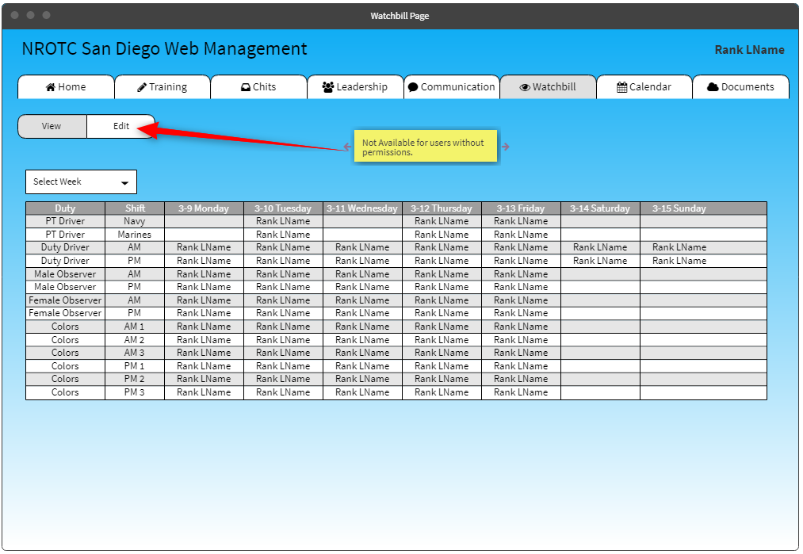
Functional Requirements
SCH.WB.01 The system shall implement a ’Watchbill’ scheduling system.

Slide 21
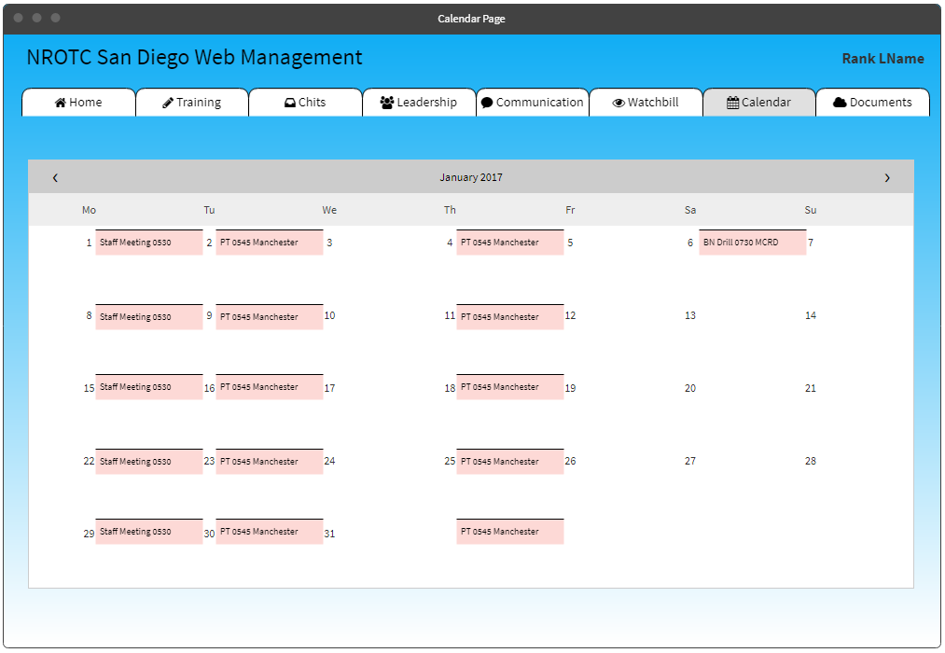
Functional Requirements
Extra feature if time allows, to automatically populate a calendar with any training events made.

Slide 22
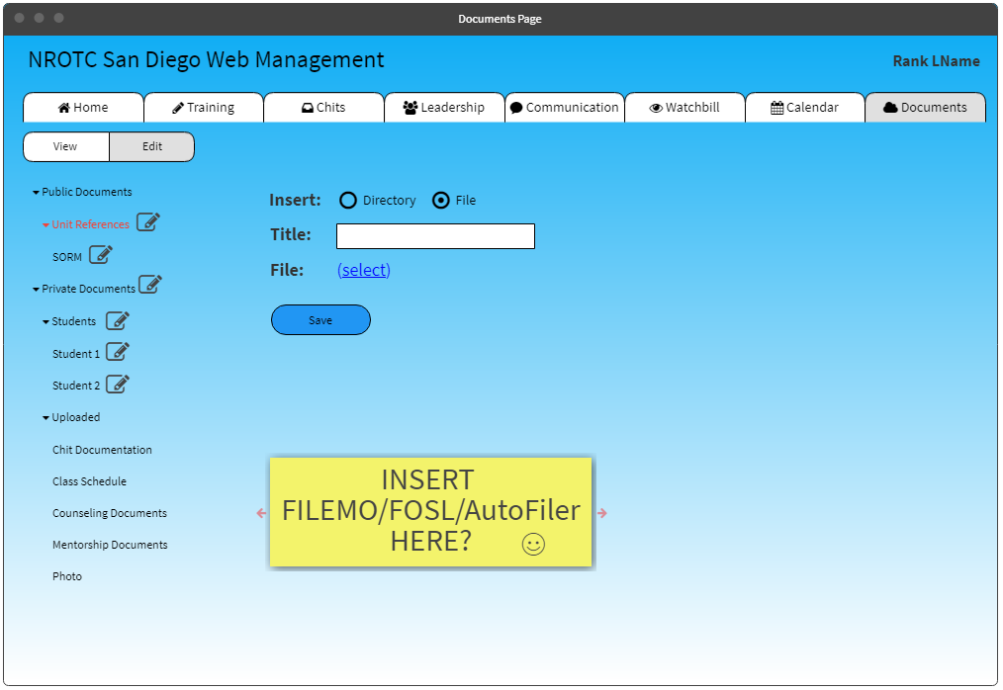
Functional Requirements
DS.01 The system shall have a document storage section to be accessible by all users.
DS.02 The system shall have a private document storage section for certain users (Staff members).
DS.03 The system shall have a private document storage section to be accessible for chits by only authorized users that have chit review authority.

Slide 23

Questions?
Support the troops, vote for U.S.!

